Slide 1

ui design & implementation
Task 4 – by group 2

Slide 2

introduction

Slide 3
App identity
"Diagnose. Understand. Repair."
👤 Target Users: Car Owners & Mechanics
🎯 App Purpose: Detect car faults using dashboard images
and engine sound
🛠️ Brand Theme: Reliable, intelligent, and user-friendly

Slide 4
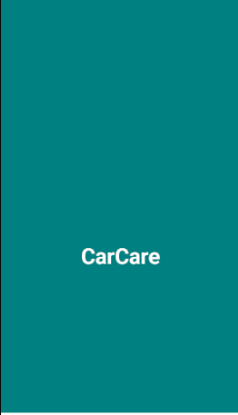
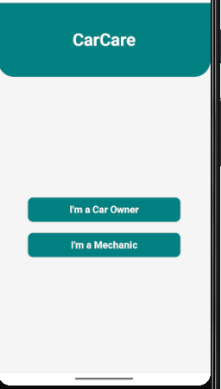
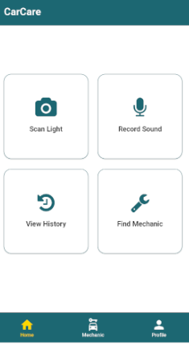
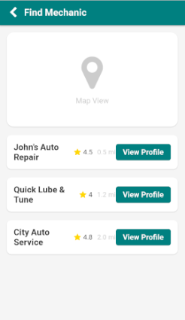
Visual design

Slide 5
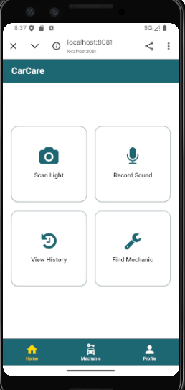
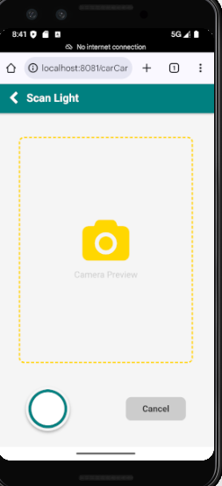
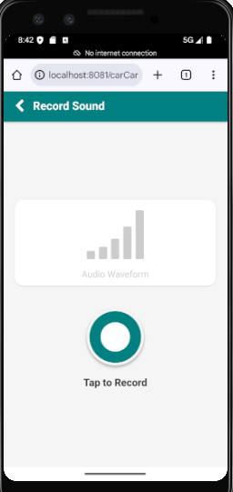
Frontend implementation

Slide 6
Conclusion & demo

